Slide 1
PORTABLE TABLE TOP SPOT WELDING MAHCINE

Slide 2
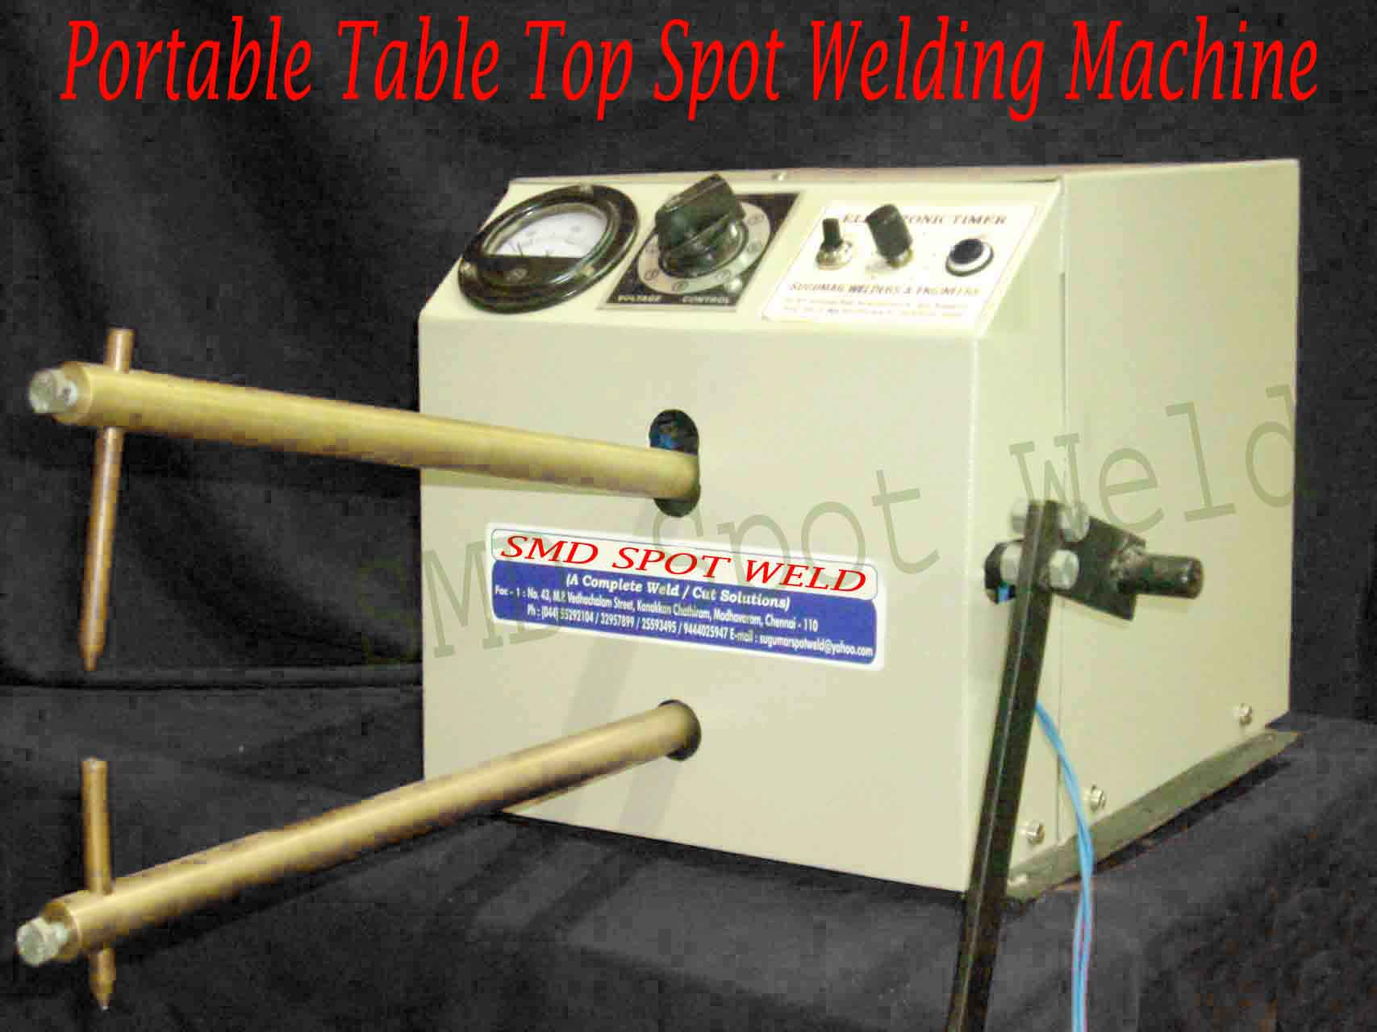

Slide 3
Portable Table Top Pedal Operated Spot Welding Machine
MODEL |  |  | TT ----2.5 |  | TT ----3.5 | TT ----5
TYPE | Table top portable foot operated spot welder
KVA |  |  |  | 2.5 kva | 3.5 kva |  | 5 kva
DUTY CYCLE |  |  |  | 50 % | 50 % |  | 50 %
INPUT @ 50 hz |  |  |  | 220 V (1 phase) | 220 V (1 phase) |  | 415 V (2 phase)
Throat Depth |  |  |  | 200 mm | 200 mm |  | 200 mm
Throat Gap |  |  |  | 50 mm | 50 mm |  | 50 mm
Throat Rod Dia Welding thick – SS |  |  |  | 0.5 to 1mm X 2 no | 0.5 to 1.2mm X 2 no |  | 0.7 to 1.4 mm SS & MS-2 no 0.5 to 1 mm SS & MS-2 no
Cooling |  |  |  | Air Cooled | Air Cooled |  | Water cooled (without pump)
Control |  | Electronic Timer with Electro Magnetic Contactor

